Slide 1



Law is everywhere
BETTER HEALTH FASTER
3rd lecture in the SSPH+/ETH Jubilee Series “This Is Public Health”
Wed 4.3.2020 – 17:15h (CET) @ ETH Zurich HG D16.2 and
live-streamed online https://ethz.zoom.us/j/253320154
Prof. Dominique Sprumont
Deputy Director, Institute of Health Law, University Neuchâtel
President, Research Ethics Commitee of Vaud, Lausanne
March 4, 2020

Slide 2

He Er Bu Tong
Seeking Harmony in spite of the differences
Confucius
T
https://www.youtube.com/watch?v=NNC0kIzM1Fo

Slide 3
This is a Meta-Course
How can we convince the NON-LAWYERS who do most public health work to work with us?
How can we use law more effectively in public health work?

Slide 4
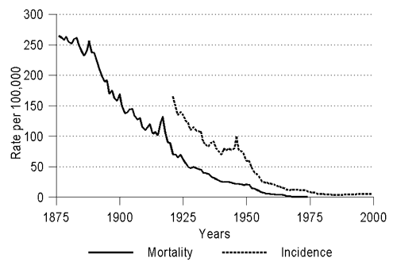
Tuberculosis:
moratility and incidence rate during 125 years in Danemark
Statens Serum Institut, Rigs­hospitalet (National Hospital), University of Copenhagen, Copenhagen, Denmark; Gentofte University Hospital, Hellerup, Denmark
Discovery of the tubercle bacillus
anti-tuberculosis
treatment
Vaccine
BCG

Slide 5
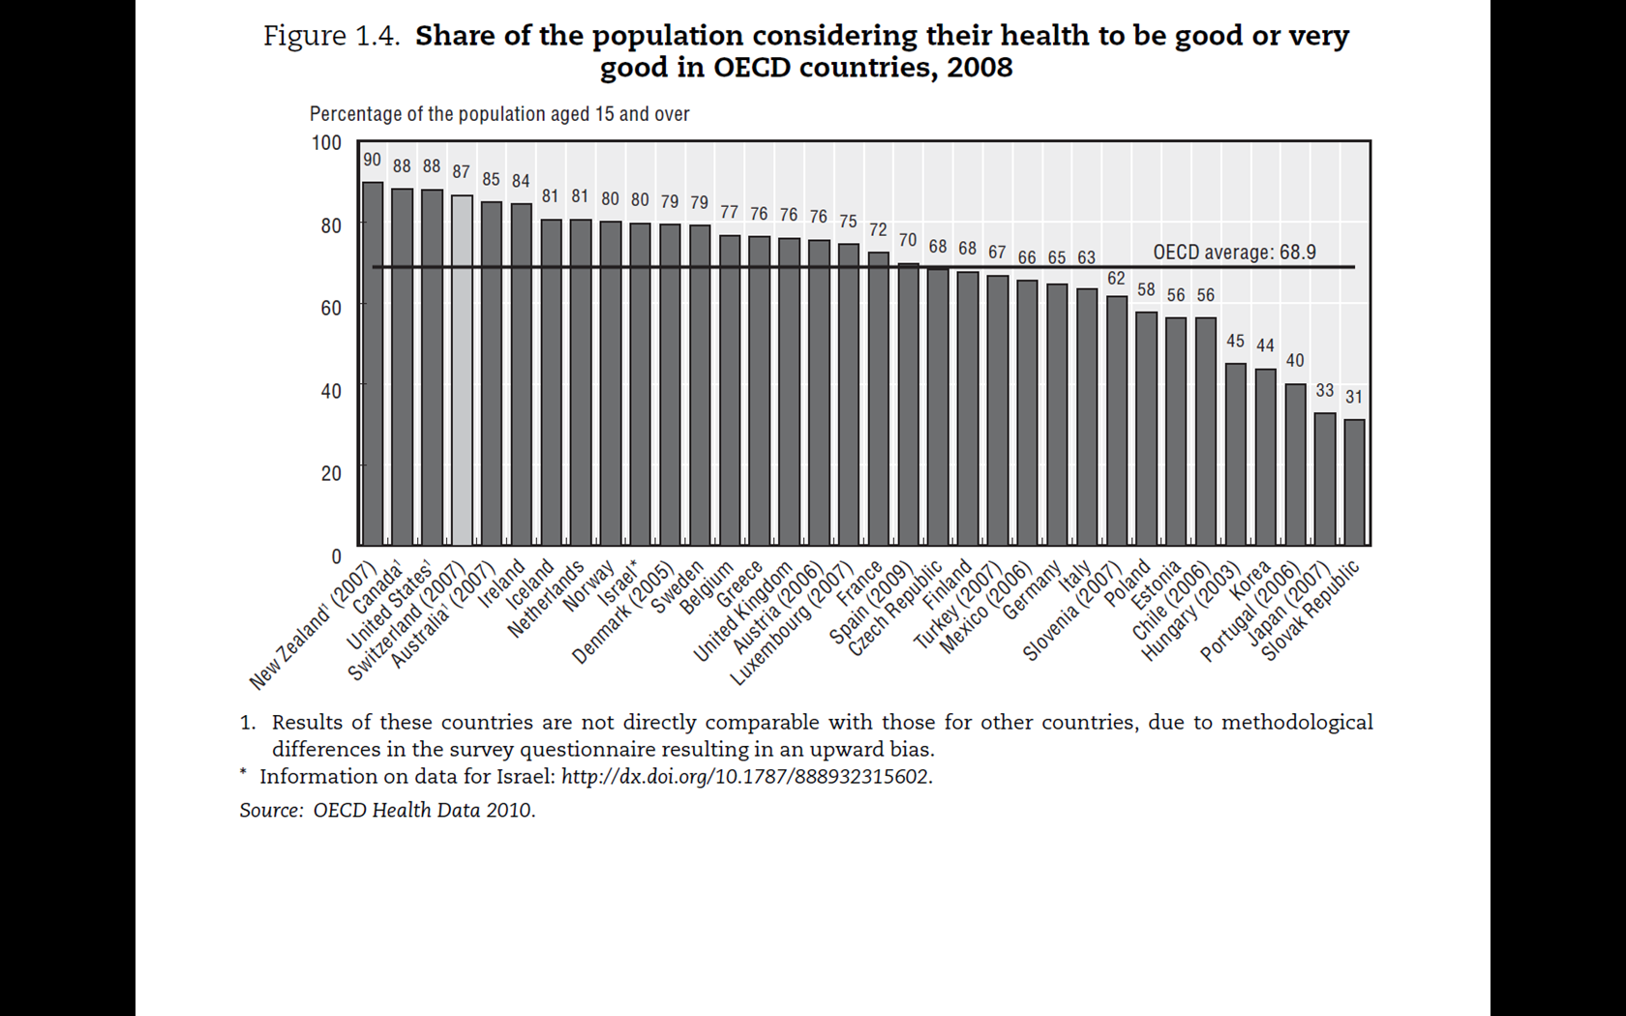
Switzerland: 2012 = 90%
Neuchâtel = 75%

Slide 6
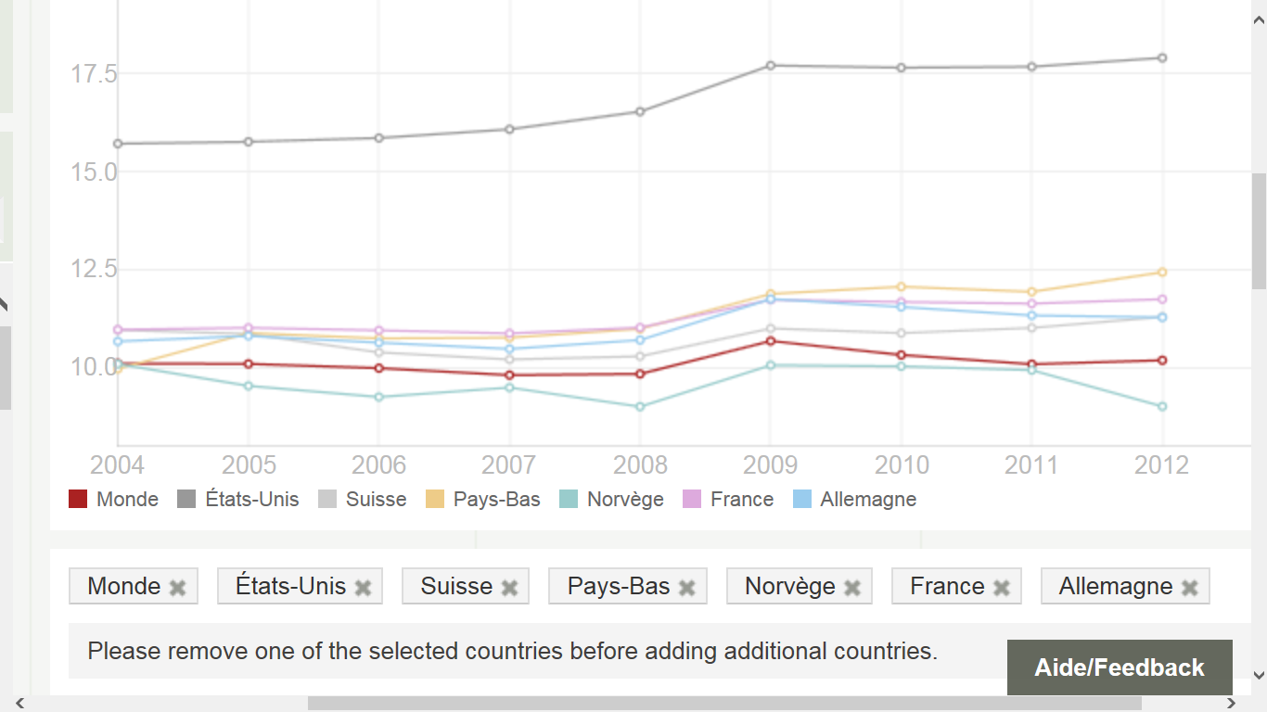
Healthcare spending and GDP (%) World BANK
http://donnees.banquemondiale.org/indicateur/SH.XPD.TOTL.ZS/countries/1W-US-CH-NL-NO-FR-DE?display=graph

Slide 7
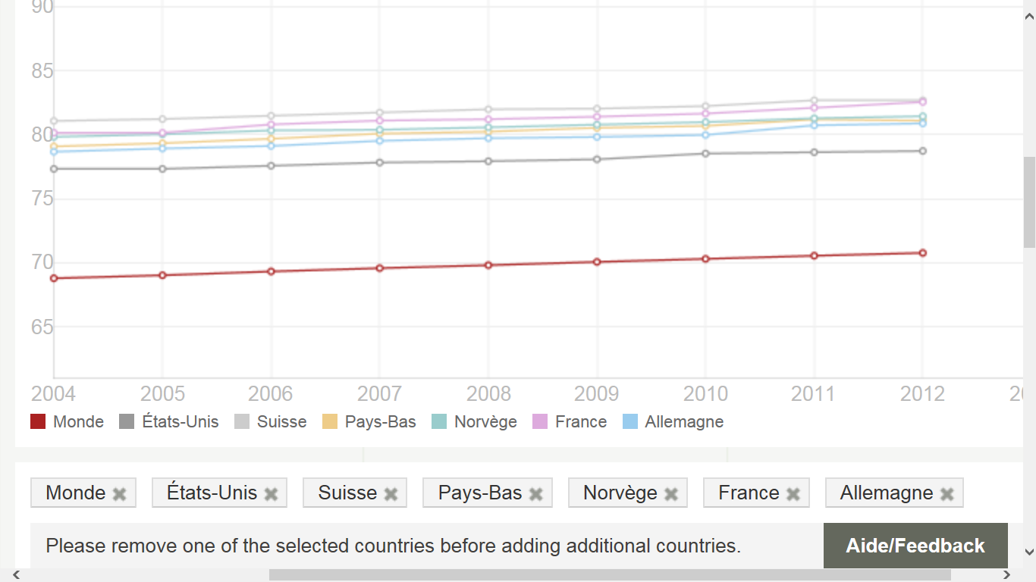
Life expenctancy at birth (World bank)
http://donnees.banquemondiale.org/indicateur/SP.DYN.LE00.IN/countries/1W-US-CH-NL-NO-FR-DE?display=graph

Slide 8
Health System v. healthcare Systems:
Robert Evans’ Model (OECD)
EVANS Robert G. et STODDART Gregory L., Producing health, consuming health care, Soc. Sci. Méd. Vol. 31 No. 12, pp 1347- 1363, 1990
Health system
social
physical
environnement
Genetic
Inheritance
environment
Individual answer
behavioral
biological
Healthcare system
health
&
function
disease
healthcare
Well-being
Economic
prosperity

Slide 9
HEALTH DETERMINANTS
( AND % CONTRIBUTION TO LONGEVITY )
20%
BIOLOGY
GENETICS
HEALTH
REPARING
PROMOTION
HEALTHCARE
SYSTEM
(ACCESS)
SOCIO-ECONOMIC
STATUS
BEHAVIOR
(LIFE STYLES)
ATTITUDES
PROMOTION
10-15%
ENVIRONMENT
(INDOOR
OUTDOOR)
Domenighetti 2004
45-50%
20-25%
Notes:
9

Slide 10
A need of clarification ?
Fo waas redä mier ?
De quo locutum est?
De quoi parle-t-on?
What are we talking about?
Fa was rede wär?
我們正在談論什麼？

Slide 11
Proposal for a legal definition of health
In law, health is understood as a fundamental right (the right to health), as a personality right (individual right) and a public interest (community health/public health).
«La santé consiste en un état de bien-être physique, mental et social; elle relève des droits de la personne» (Loi sanitaire, Jura, 1990)
«La santé, comme état de bien-être physique, psychique et social qui ne s’apprécie pas uniquement en fonction de la maladie ou du handicap, est un bien fondamental qui doit être protégé» (Loi sur la santé, Fribourg, 1999)

Slide 12
Dynamic Definition of Health Law
Public health law is the study of the legal powers and duties of the state, in collaboration with its partners (e.g., health care, business, the community, the media, and academe), to assure the conditions for people to be healthy (to identify, prevent, and ameliorate risks to health in the population) and the limitations on the power of the state to constrain the autonomy, privacy, liberty, proprietary, or other legally protected interests of individuals for the common good.
Lawrence Gostin, Public Health Law in a New Century. Part 1, JAMA, June 7, 2000-Vol 283, No. 21 2837
PUBLIC HEALTH IS ALSO ABOUT HUMAN RIGTHS AND FUNDAMENTAL FREEDOMS

Slide 13
What is health law?
Fo waas redä mier ?
De quo locutum est?
De quoi parle-t-on?
What are we talking about?
Fa was rede wär?
我們正在談論什麼？

Slide 14
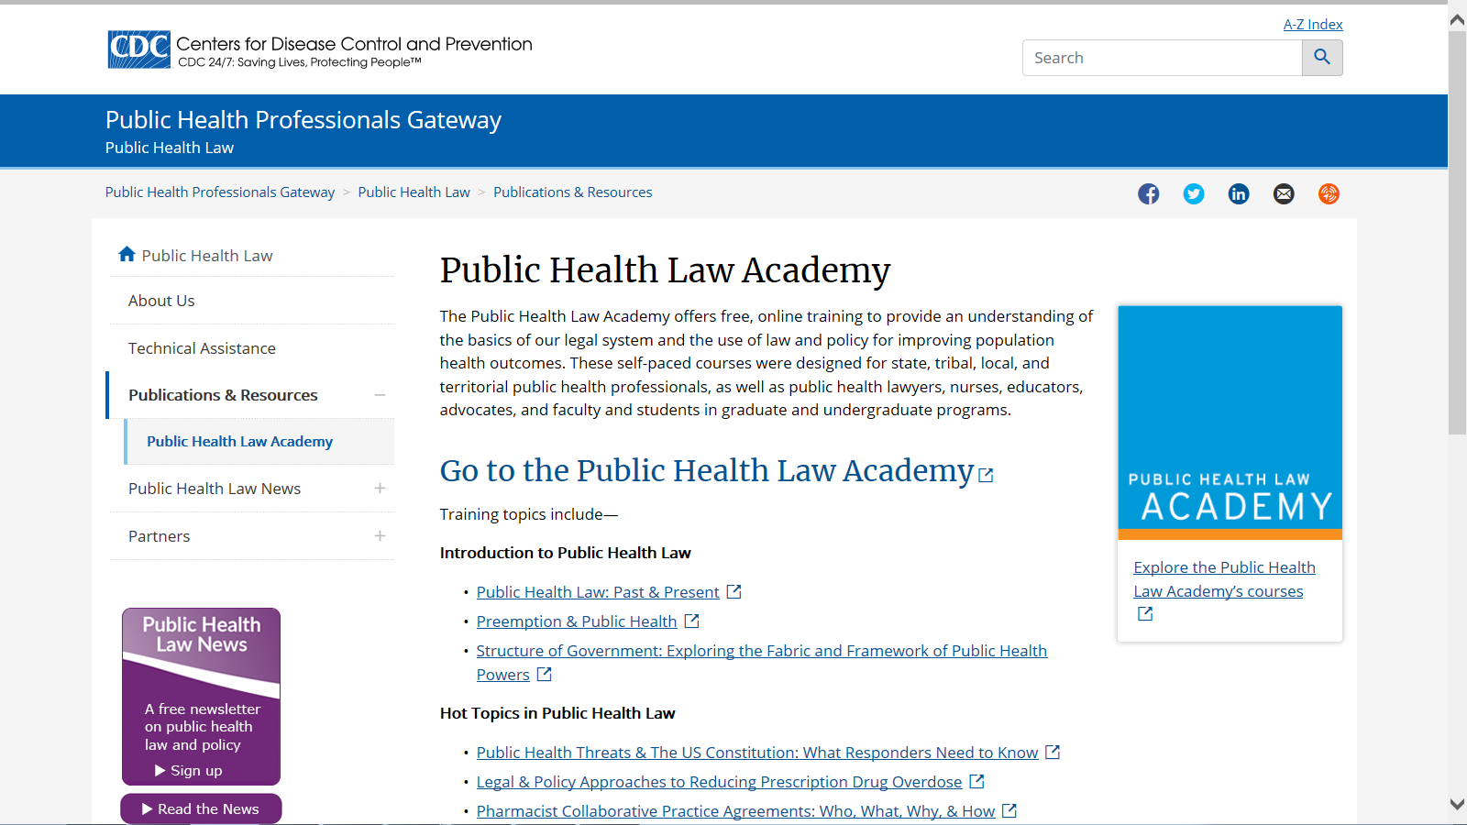
https://www.cdc.gov/phlp/publications/topic/phlacademy.html

Slide 15
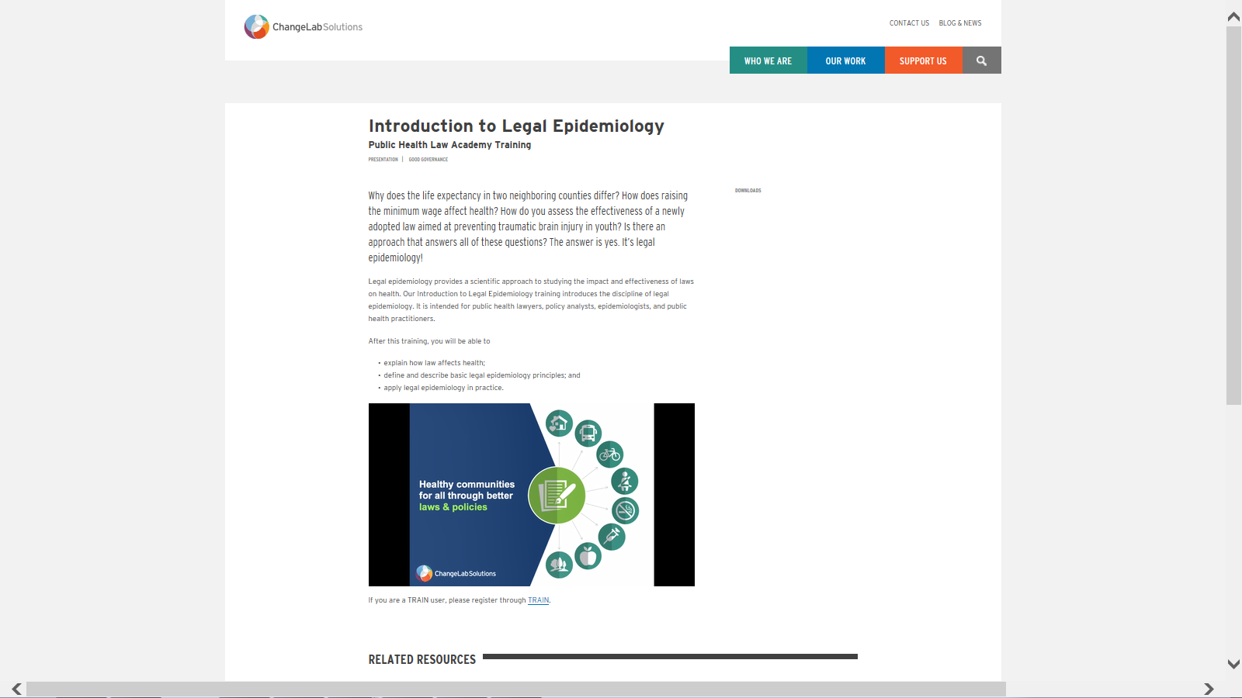
https://www.changelabsolutions.org/product/introduction-legal-epidemiology

Slide 16
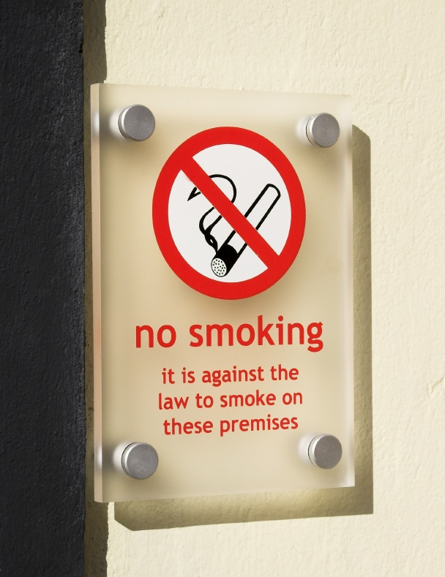
Health laws is… Health laws
    “Interventional Public Health Law”
    →laws intended to influence health outcomes or mediators

Slide 17
10 Essential public health elements
Surveillance of population health and well-being
Monitoring and response to health hazards and emergencies
Health protection, including environmental, occupational, occupational, and food safety
Health promotion, including action to address social determinants and health inequity
Disease prevention, including early detection of illness
Assuring governance for health
Assuring a competent public health workforce
Assuring organizational structures and financing
Information, communication, and social mobilization for health
Advancing public health research to inform policy and practice.
https://www.cdc.gov/stltpublichealth/publichealthservices/essentialhealthservices.html

Slide 18
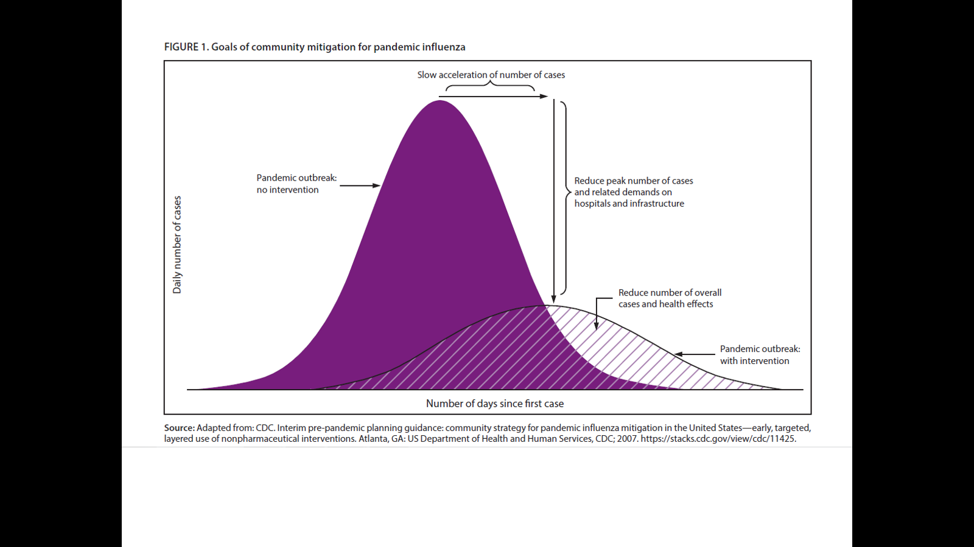
Pandemic: Moving From Containment
To Mitigation
Social distancing
Recommendations and Reports / Vol. 66 / No. 1 April 21, 2017
    Community Mitigation Guidelines to Prevent Pandemic Influenza — United States, 2017

Slide 19
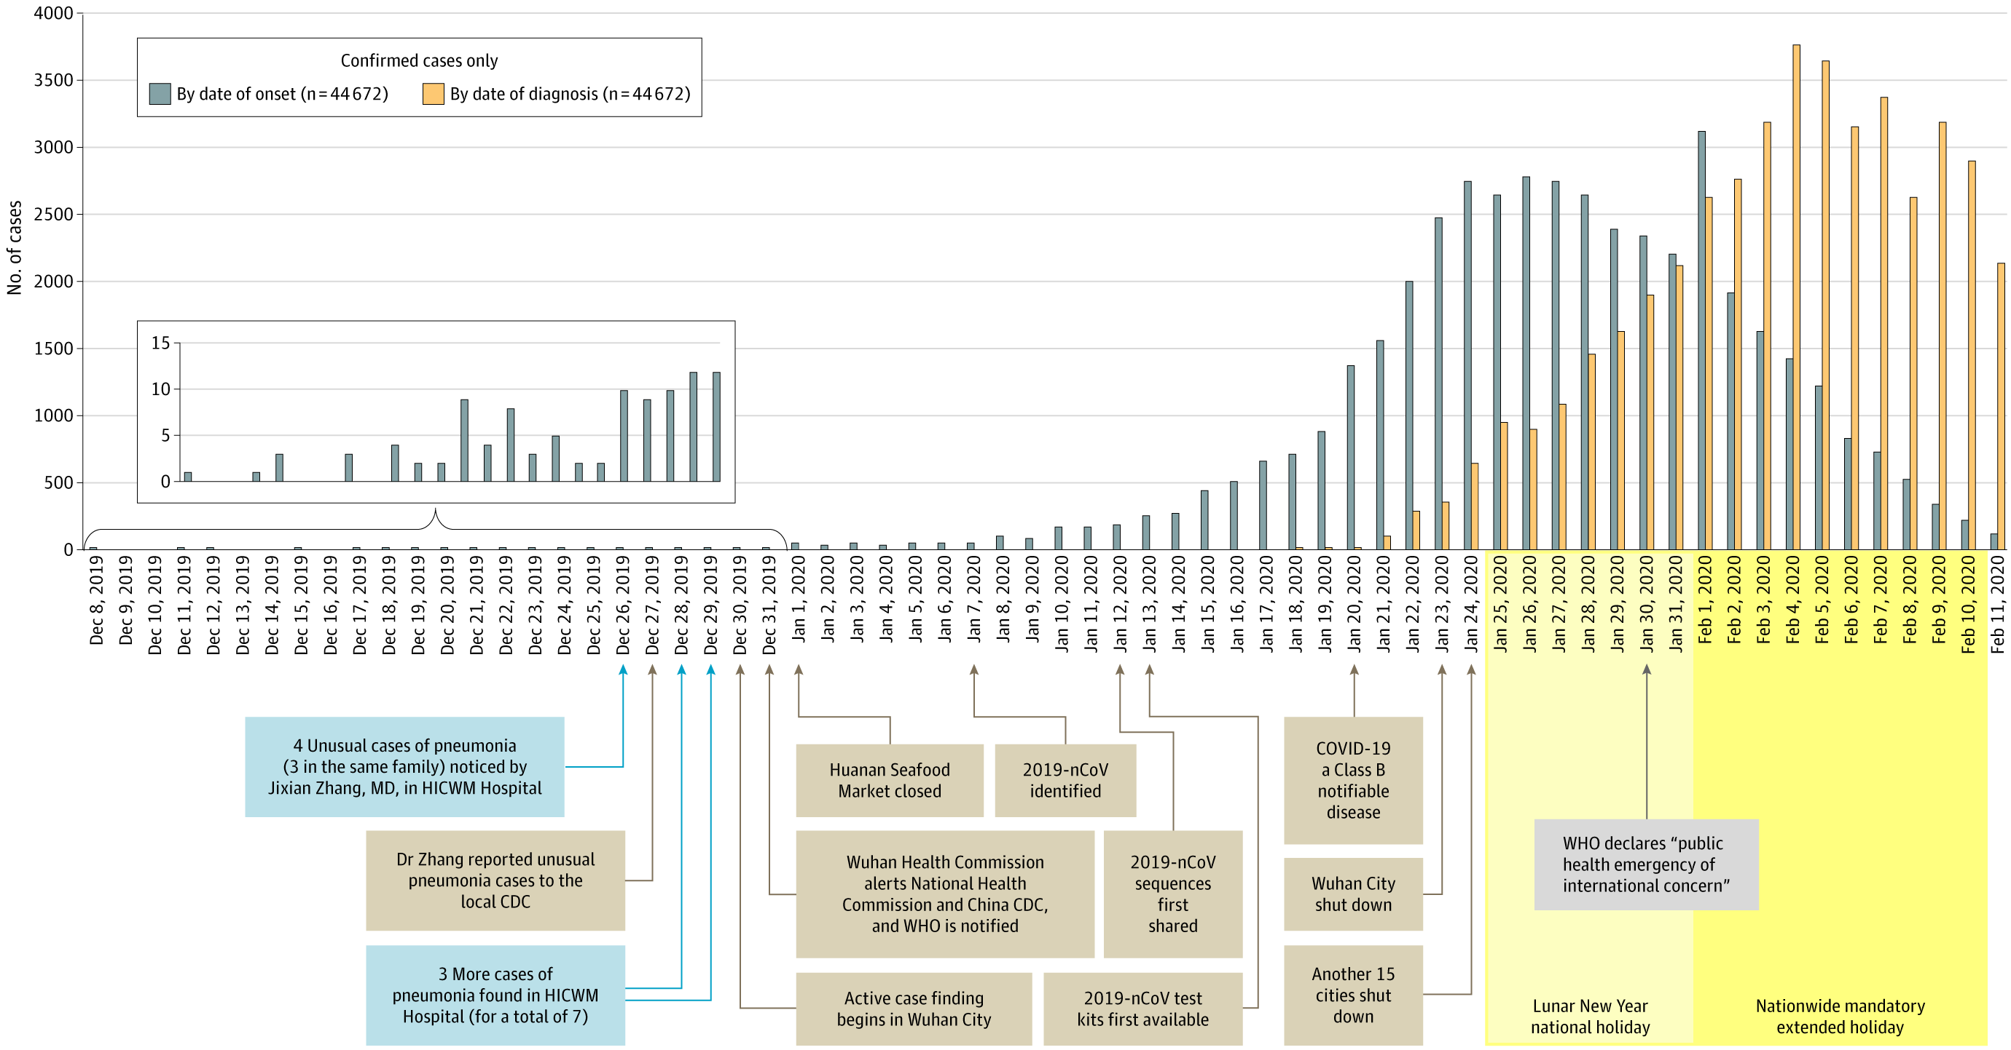
Li Wenliang warns his colleagues about 7 suspect cases of hospitalized patients. He is arrested on January 1, 2020 for "making false comments on the Internet". Dies from COVID 19 on February 7, 2020
From: Characteristics of and Important Lessons From the Coronavirus Disease 2019 (COVID-19) Outbreak in China: Summary of a Report of 72 314 Cases From the Chinese Center for Disease Control and Prevention
JAMA. Published online February 24, 2020. doi:10.1001/jama.2020.2648

Slide 20
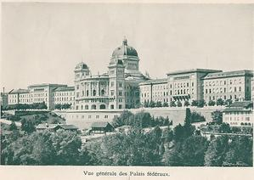

And more than health laws
    “Infrastructural Public Health Law”
    → laws establishing the powers, duties, and structure of public health agencies

Slide 21
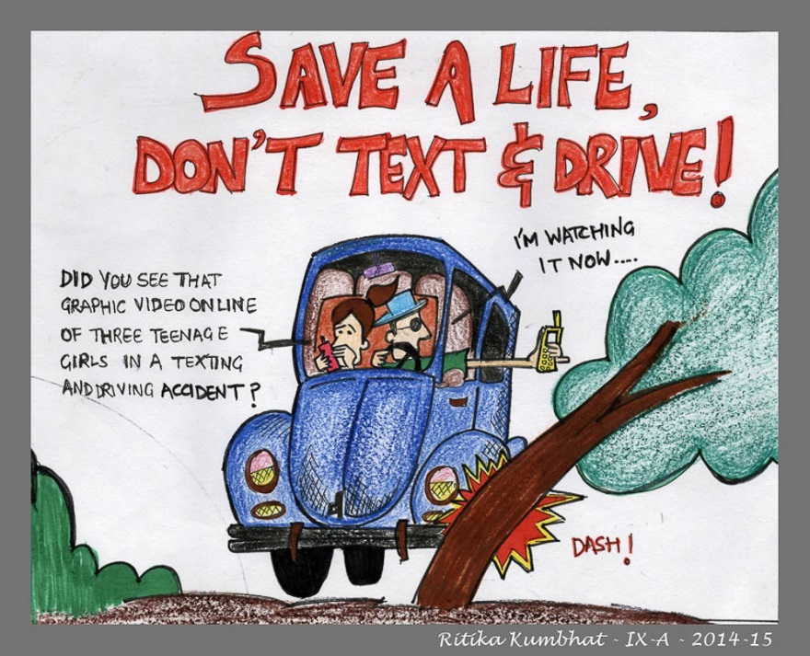
And more than health laws
    “Incidental Public Health Law”
    → laws, regardless of topic or purpose, that are studied for their impact on public health
Road Safety Message from Ritika Kumbhat Class-IX-A-DPS Surat

Slide 22
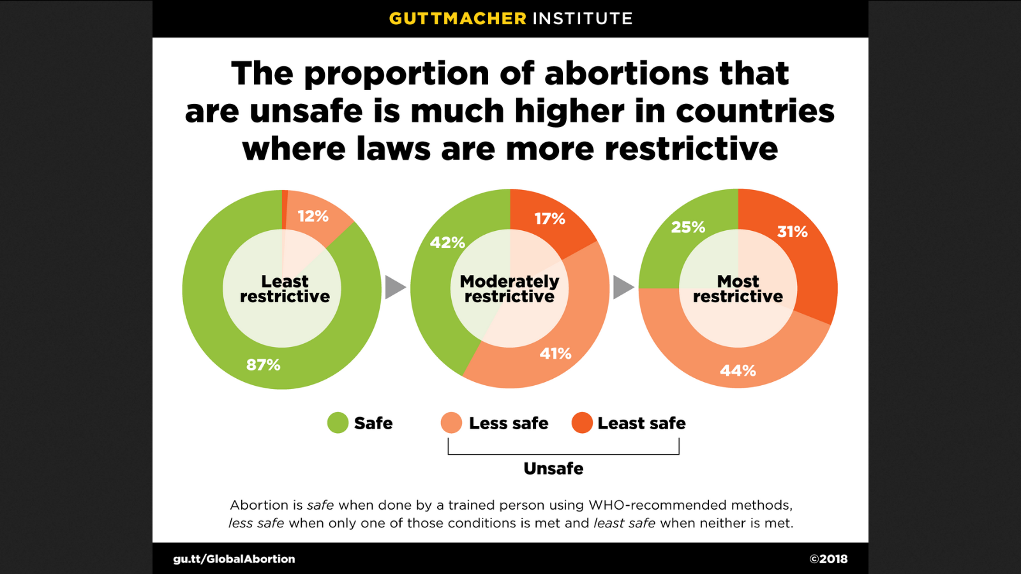
Incidental Health Law
https://www.guttmacher.org/sites/default/files/395-419.png
47’000 women die
every year from an abortion

Slide 23
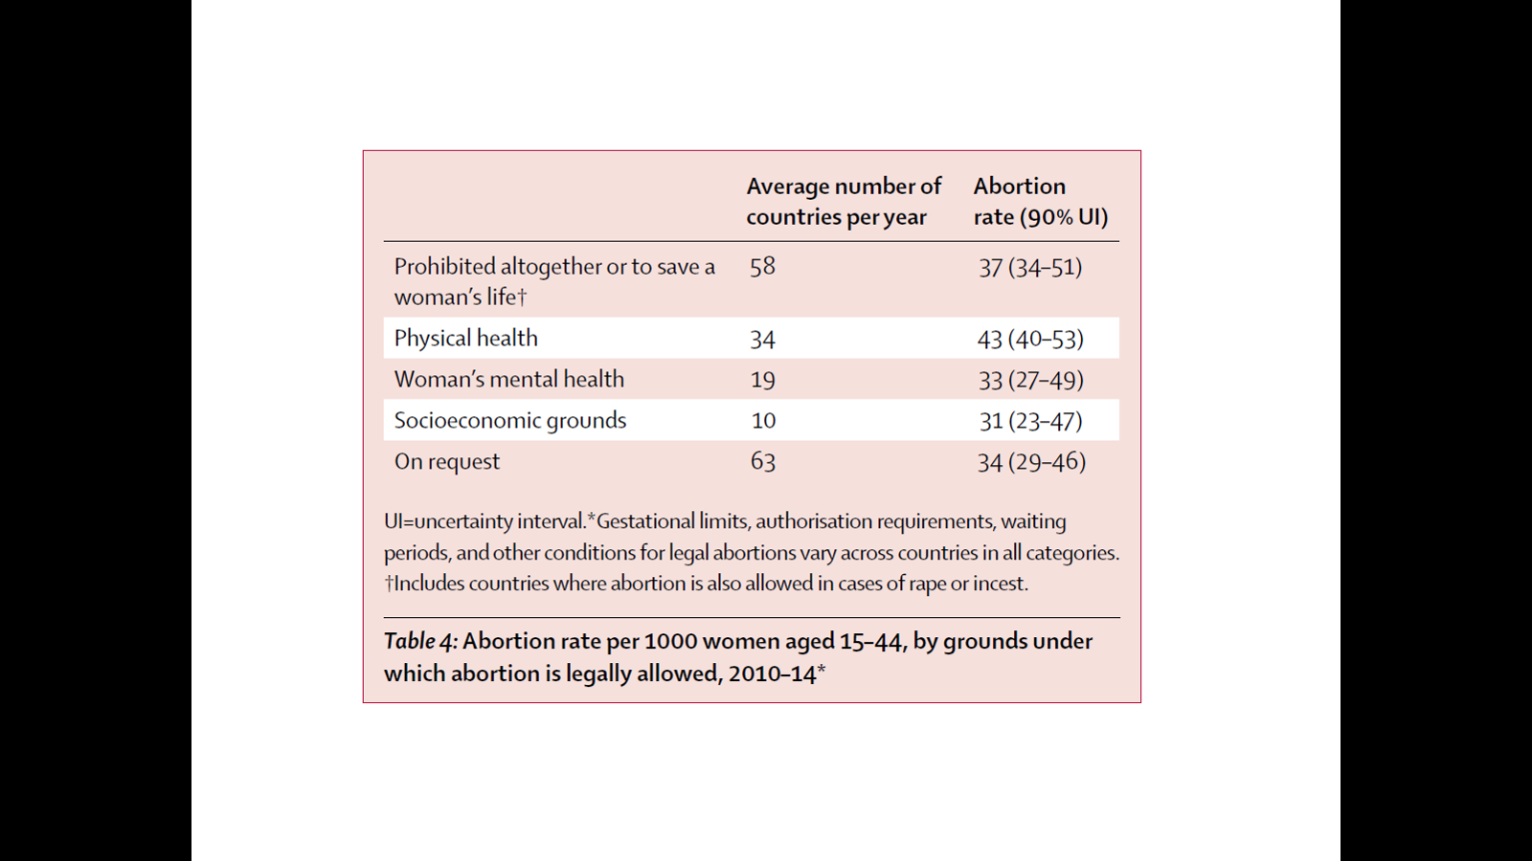
Abortion incidence between 1990 and 2014:
global, regional, and subregional levels and trends
Gilda Sedgh et al., Lancet 2016; 388: 258–67
https://www.thelancet.com/journals/lancet/article/PIIS0140-6736(16)30380-4/fulltext

Slide 24
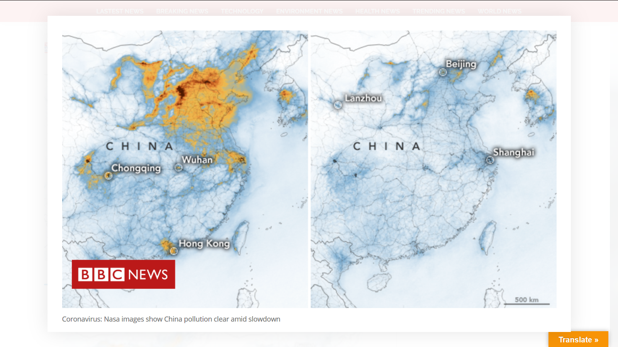
Coronavirus: Nasa images show China pollution clear amid slowdown
https://www.bbc.com/news/world-asia-51691967
January 1-20, 2020
February 10-25, 2020
https://www.researchgate.net/publication/12149707_Impact_of_Changes_in_Transportation_and_Commuting_Behaviors_During_the_1996_Summer_Olympic_Games_in_Atlanta_on_Air_Quality_and_Childhood_Asthma

Slide 25
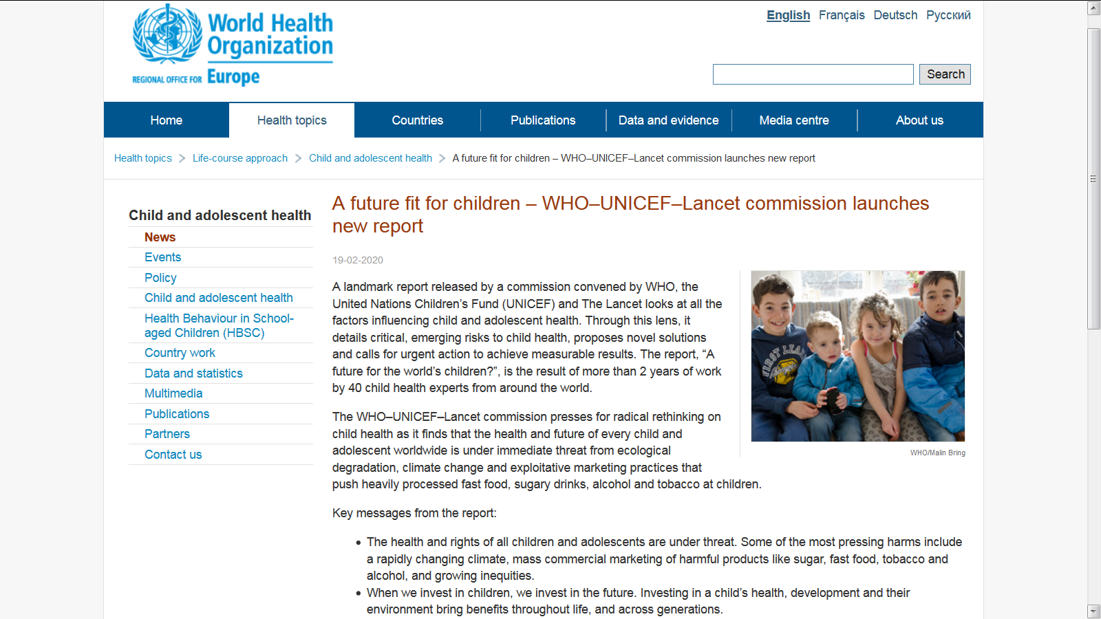
https://www.who.int/news-room/campaigns/a-future-fit-for-children /

Slide 26
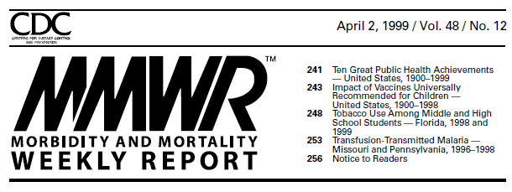
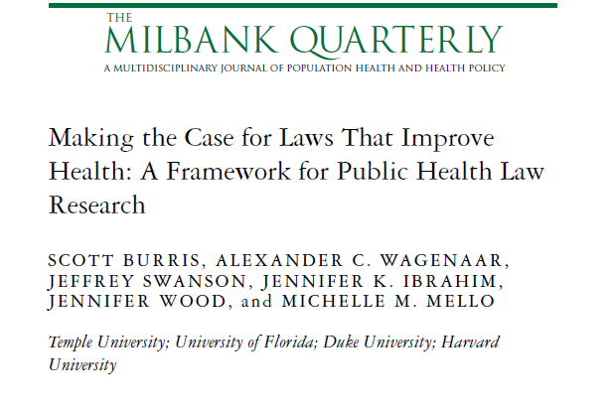
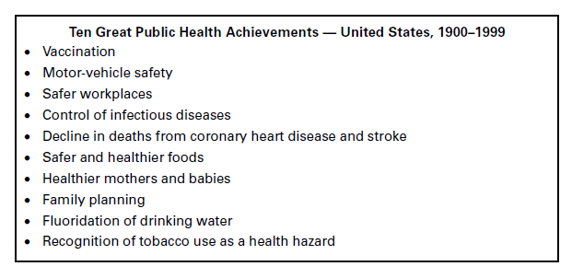
Premise 1:
Law is Essential to public health

Slide 27
Premise 2:
Law is not just a “tool”
“Interventional public health laws”
  →laws intended to influence health
“Infrastructural public health law”
  defines powers, duties, jurisdictions of health agencies
“Incidental public health law”
  laws not enacted or implemented with health in mind, but that have important health effects

Slide 28
Premise 3:
Law is one of the ONLY ways to understand and address social determinants of health
Frieden, T. R. (2010). A Framework for Public Health Action: The Health Impact Pyramid. Am J Public Health, 100(4), 590-595. doi: 10.2105/ajph.2009.185652

Slide 29

WHO 2017
http://www.who.int/healthsystems/topics/health-law/health_law-report/en/

Slide 30
Sustainable Development Goals 2015
Goal 3: Ensure healthy lives and promote well-being for all at all ages
16.3 Promote the rule of law at the national and international levels and ensure equal access to justice for all
«salus populi est suprema lex»
Cicero, De Legibus, Livre III, part. III, subd. VIII
http://www.un.org/sustainabledevelopment/sustainable-development-goals/

Slide 31
Two Ways Law Influences Health
2. Laws influence behavior
Health
1. Laws shape contexts
Social
determinants
of health
Drug policy
Public safety
Housing
OSH and work law
School discipline
Criminal justice

Slide 32
Evidence-Based Policy is an Output
New policies have no evidence base
Policy starts as a guess
Refinement and diffusion
Evidence-based policy
Research KNOWLEDGE about problems and possible solutions helps make it an EDUCATED guess
EVALUATION research tells us what works and how to make it work better

Slide 33
The 5 essential services of public health law
The right thing to do
Drafting laws, regulations, guidelines
Developing consensus and support
Enforcement strategies
Monitoring and evaluation
Access to Evidence and Expertise
Expertise in Designing Legal Solutions
Help Engaging Communities and Building Political Will
Support for Enforcing and Defending Legal Solutions
Policy Surveillance and Evaluation
Better Health Faster
Evaluation Research
Informing policy refinement

Slide 34
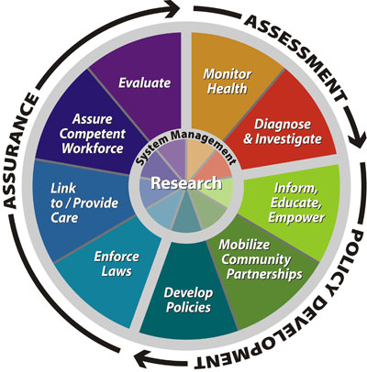
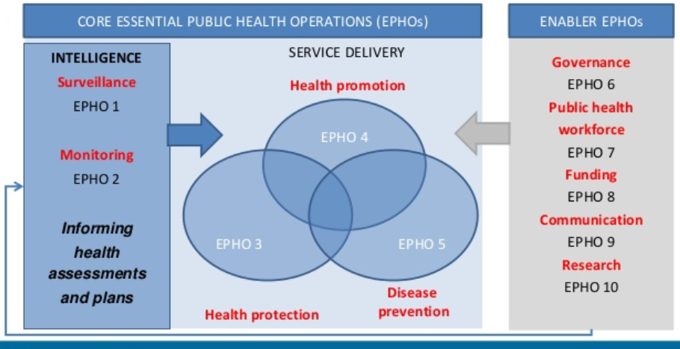
A Model with a 2 Decade
+ Global Track Record
WHO/Euro Model
CDC/US Model

Slide 35
The Traditional View
For as long as Public Health Law has been a field, we have never questioned two basic assumptions:
Public Health Law is primarily an activity of lawyers, and
This activity consists primarily of traditional legal work and roles: legal research, counsel and representation

Slide 36
Let’s Call that “Public Health Law Practice”
Counsel
Public Health Law Practice
Research
Represen-tation

Slide 37
This Was a Mistake
Counsel
We should have questioned these two assumptions – and this model -- a long time ago, because they are wrong and actually impede the integration of law into public health practice.
Public Health Law Practice
Research
Represen-tation

Slide 38
The Other Part of Public Health Law:
Legal Epidemiology
Legal etiology
The study of laws and legal practices as causes of disease and disease risk
Policy surveillance
The scientific tracking of policies important to health → Public access to legal information and data
Legal prevention and control
The study of laws and legal practices as interventions to prevent and control disease
The scientific study of law as a factor in the cause, distribution and prevention of disease in a population
Notes:
And as I thought about this as public health law, another diagram came to mind:

Slide 39
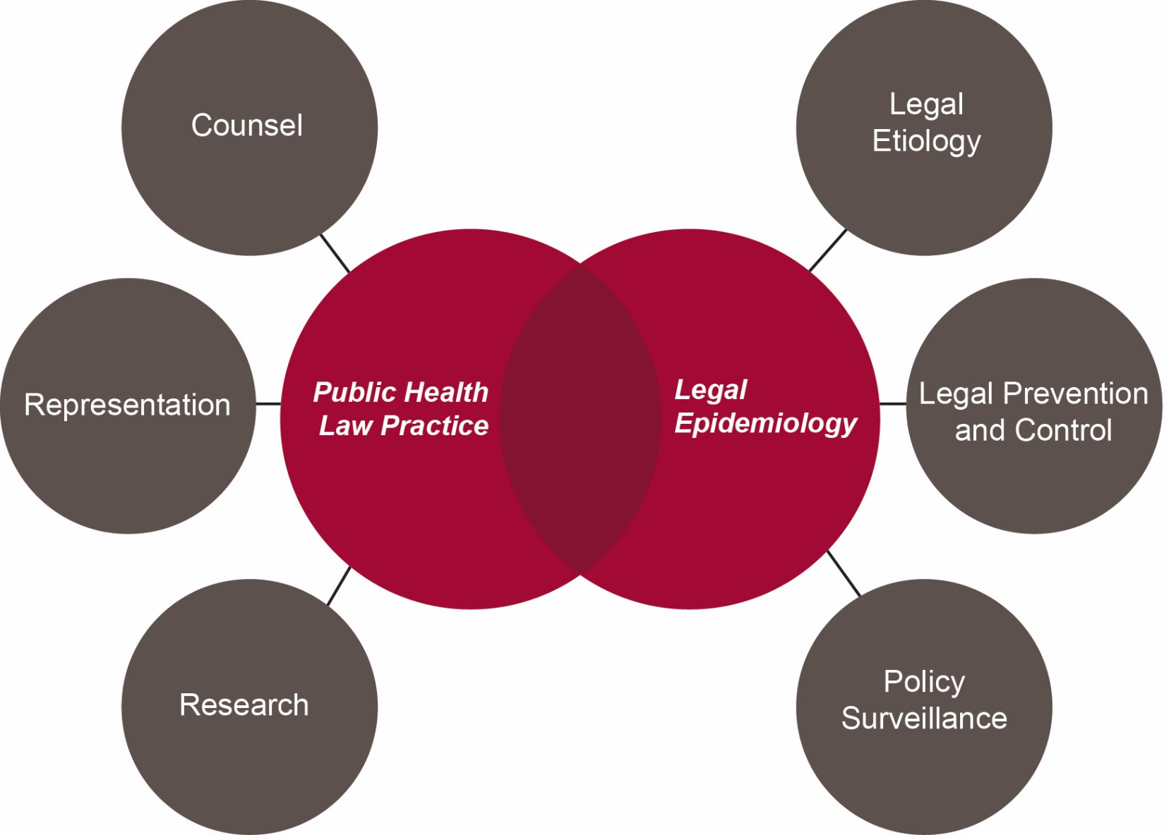
A Transdisciplinary Model

Slide 40
The Prescription
Break down the chronic cultural barriers by adopting a transdisciplinary model.
Improve performance by ensuring that the full spectrum of public health law functions are being conducted, and optimize performance in each domain
Better Health Faster

Slide 41
Indicators of Progress
Lawyers
Understand law and its operation in scientific terms
Use scientific methods in legal work
Health professionals
Understand and study law within PH science
Monitor and timely evaluate legal interventions
Health agencies have adequate legal support
Legal TA is routine
Effective measures are rapidly identified and adopted

Slide 42
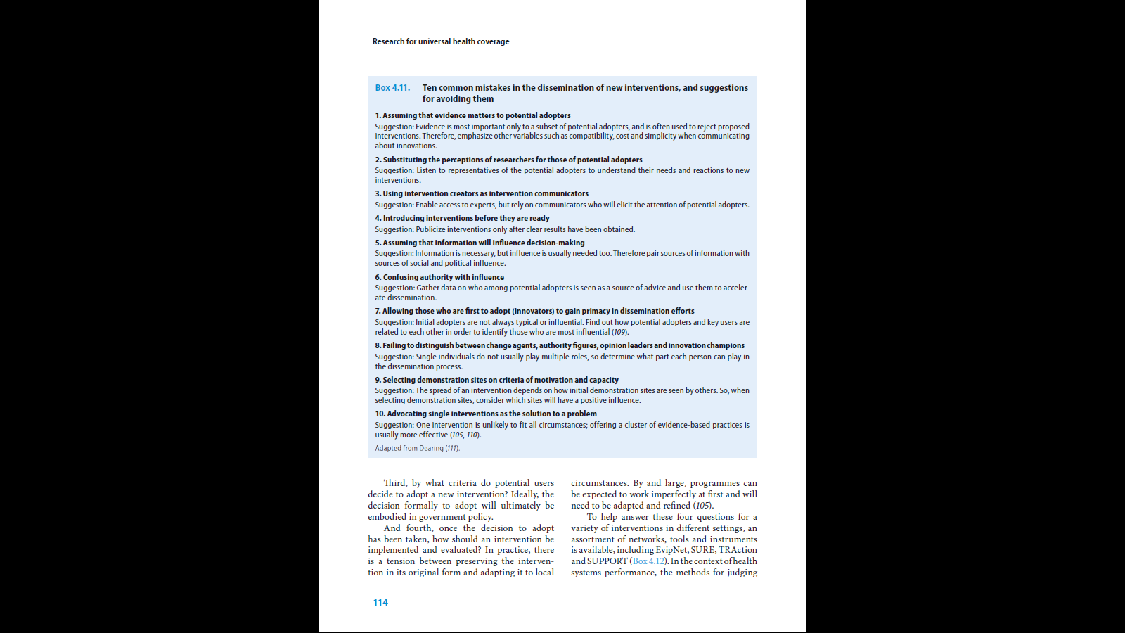
Points to Consider
World health report 2013: Research
for universal health coverage p. 132
http://www.who.int/whr/en/
What is the likelihood to change the majority at the Federal Assembly?
  At the individual level?
  At the parties level? In particular which party is likely to switch position?
What arguments or actions are likely to contribute to a change of majority at the Federal Assembly? At least is it possible to build alliances on specific issues and if so which ones?
What is the position of the Sickness Funds?
The failure of public health community with the Tobacco Product Act in 2016
AND
The success of the public health community with the Tobacco Product Act in 2019

Slide 43

Course, Aug 27 – 29, 2020:
Better Health Faster: Using Law and Policy Effectively in Public Health
www.ssph-lugano-summerschool.ch

Slide 44

Objectifs d’enseignement
And always remember that LAW IS EVERYWHERE…
https://www.youtube.com/watch?v=NNC0kIzM1Fo
Formation continue CER-VD/CER-GE
Prangins le 22 novembre 2018

Slide 45
Dominique Sprumont
dominique.sprumont@unine.ch

Slide 46

The law on tobacco products: impacting public health through legislative changes - opportunities and limits
Coming up next week:
Prof. Luciano Ruggia
Research Fellow at the Institute of Social and Preventive Medicine (ISPM) of the University of Bern
Director of the Swiss Association for Smoking Prevention AT
March 11, 2020

